Slide 1
CS 540 Database Management Systems
Lecture 12: NoSQL & NewSQL

Slide 2
Motivation
Web 2.0 applications
thousands or millions of users.
users perform both reads and updates.
How to scale DBMS?
Vertical scaling: moving the application to larger computers: multiple cores and/or CPUs
limited and expensive!
Horizontal scaling: distribute the data and workload over many servers (nodes)

Slide 3
DBMS over a cluster of servers
QUERY
Client-Server
Client ships query
to single site. All query
processing at server.
CLIENT
CLIENT
SERVER
SERVER
SERVER
SERVER
Collaborating-Server
SERVER
Query can span multiple
sites.
SERVER
QUERY

Slide 4
Data partitioning to improve performance
TID
t1
t2
t3
t4
Sharding: horizontal partitioning by some key and store records on different nodes.
Vertical: store sets of attributes (columns) on different nodes: Lossless-join; tids.
Each node handles a portion read/write requests.

Slide 5
Replication
Gives increased availability.
Faster query (request) evaluation.
each node has more information and does not need to communicate with others.
Synchronous vs. Asynchronous.
Vary in how current copies are.
node A
R1
R3
node B
R1
R2

Slide 6
Replication: consistency of copies
Synchronous: All copies of a modified data item must be updated before the modifying Xact commits.
Xact could be a single write operation
copies are consistent
Asynchronous: Copies of a modified data item are only periodically updated; different copies may get out of synch in the meantime.
copies may be inconsistent over periods of time.

Slide 7
Consistency
Users and developers see the DBMS as coherent and consistent single-machine DBMS.
Developers do not need to know how to write concurrent programs => easier to use
DBMS should support ACID transactions
Multiple nodes (servers) run parts of the same Xact
They all must commit, or none should commit

Slide 8
Xact commit over clusters
Assumptions:
Each node logs actions at that site, but there is no global log
There is a special node, called the coordinator, which starts and coordinates the commit process.
Nodes communicate through sending messages
Algorithm??

Slide 9
Two-Phase Commit (2PC)
Node at which Xact originates is coordinator; other nodes at which it executes are subordinates.
When an Xact wants to commit:
Coordinator sends prepare msg to each subordinate.
Subordinate force-writes an abort or prepare log record and then sends a no or yes msg to coordinator.
If coordinator gets unanimous yes votes, force-writes a commit log record and sends commit msg to all subs. Else, force-writes abort log rec, and sends abort msg.
Subordinates force-write abort/commit log rec based on msg they get, then send ack msg to coordinator.
Coordinator writes end log rec after getting all acks.

Slide 10
Comments on 2PC
Two rounds of communication: first, voting; then, termination. Both initiated by coordinator.
Any node can decide to abort an Xact.
Every msg reflects a decision by the sender; to ensure that this decision survives failures, it is first recorded in the local log.
All commit protocol log recs for an Xact contain Xactid and Coordinatorid. The coordinator’s abort/commit record also includes ids of all subordinates.

Slide 11
Restart after a failure at a node
If we have a commit or abort log rec for Xact T, but not an end rec, must redo/undo T.
If this node is the coordinator for T, keep sending commit/abort msgs to subs until acks received.
If we have a prepare log rec for Xact T, but not commit/abort, this node is a subordinate for T.
Repeatedly contact the coordinator to find status of T, then write commit/abort log rec; redo/undo T; and write end log rec.
If we don’t have even a prepare log rec for T, unilaterally abort and undo T.
This site may be coordinator! If so, subs may send msgs.

Slide 12
2PC: discussion
Guarantees ACID properties, but expensive
Communication overhead => I/O access.
Relies on central coordinator: both performance bottleneck, and single-point-of-failure
Other nodes depend on the coordinator, so if it slows down, 2PC will be slow.
Solution: Paxos a distributed protocol.
complex, not discussed in this class.

Slide 13
Eventual consistency
“It guarantees that, if no additional updates are made to a given data item, all reads to that item will eventually return the same value.”
Peter Bailis et. al., Eventual Consistency Today: Limitations, Extensions, and Beyond, ACM Queue
The copies are not synch over periods of times, but they will eventually have the same value: they will converge.
There are several methods to implement eventual consistency; we discuss vector clocks in Amazon Dynamo: http://aws.amazon.com/dynamodb/

Slide 14
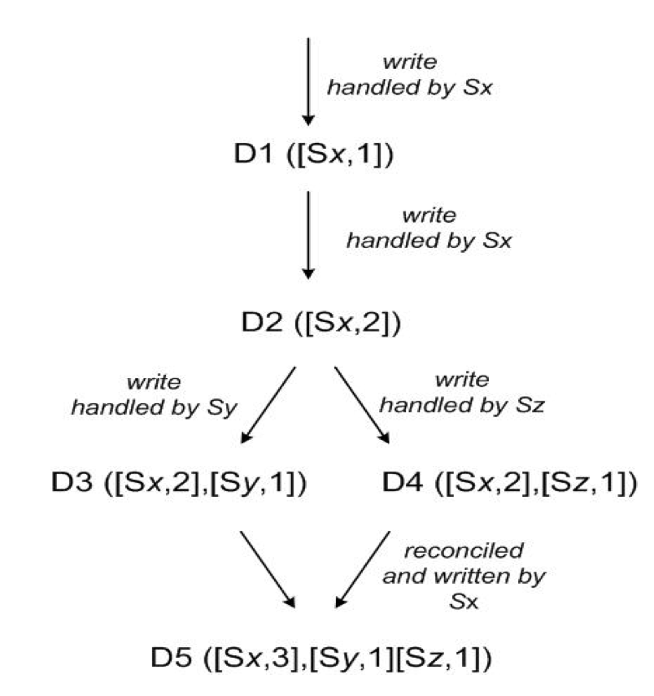
Vector clocks
Each data item X has a set of [server, timestamp] pairs
X([s1,t1], [s2,t2],...)
Example:
A client writes D1 at server SX:
D1 ([SX,1])
Another client reads D1, writes back D2; also handled by server SX:
D2 ([SX,2]) (D1 garbage collected)
Another client reads D2, writes back D3; handled by server SY:
D3 ([SX,2], [SY,1])
Another client reads D2, writes back D4; handled by server SZ:
D4 ([SX,2], [SZ,1])
Another client reads D3, D4:
CONFLICT !

Slide 15
Vector clock: interpretation
A vector clock D[(S1,v1),(S2,v2),...] means a value that represents version v1 for S1, version v2 for S2, etc.
If server Si updates D, then:
It must increment vi, if (Si, vi) exists
Otherwise, it must create a new entry (Si,1)

Slide 16
Vector clock: conflicts
A data item D is an ancestor of D’ if for all (S,v)∈D there exists (S,v’)∈D’ s.t. v ≤ v’
they are on the same branch; there is not conflict.
Otherwise, D and D’ are on parallel branches, and it means that they have a conflict that needs to be reconciled semantically.

Slide 17
Vector clock: conflict examples
Data item 1 | Data item 2 | Conflict?
([SX,3],[SY,6]) | ([SX,3],[SZ,2])

Slide 18
Vector clock: conflict examples
Data item 1 | Data item 2 | Conflict?
([SX,3],[SY,6]) | ([SX,3],[SZ,2]) | Yes
([SX,3]) | ([SX,5])

Slide 19
Vector clock: conflict examples
Data item 1 | Data item 2 | Conflict?
([SX,3],[SY,6]) | ([SX,3],[SZ,2]) | Yes
([SX,3]) | ([SX,5]) | No
([SX,3],[SY,6]) | ([SX,3],[SY,6],[SZ,2])

Slide 20
Vector clock: conflict examples
Data item 1 | Data item 2 | Conflict?
([SX,3],[SY,6]) | ([SX,3],[SZ,2]) | Yes
([SX,3]) | ([SX,5]) | No
([SX,3],[SY,6]) | ([SX,3],[SY,6],[SZ,2]) | No
([SX,3],[SY,10]) | ([SX,3],[SY,6],[SZ,2])

Slide 21
Vector clock: conflict examples
Data item 1 | Data item 2 | Conflict?
([SX,3],[SY,6]) | ([SX,3],[SZ,2]) | Yes
([SX,3]) | ([SX,5]) | No
([SX,3],[SY,6]) | ([SX,3],[SY,6],[SZ,2]) | No
([SX,3],[SY,10]) | ([SX,3],[SY,6],[SZ,2]) | Yes
([SX,3],[SY,10]) | ([SX,3],[SY,20],[SZ,2])

Slide 22
Vector clock: conflict examples
Data item 1 | Data item 2 | Conflict?
([SX,3],[SY,6]) | ([SX,3],[SZ,2]) | Yes
([SX,3]) | ([SX,5]) | No
([SX,3],[SY,6]) | ([SX,3],[SY,6],[SZ,2]) | No
([SX,3],[SY,10]) | ([SX,3],[SY,6],[SZ,2]) | Yes
([SX,3],[SY,10]) | ([SX,3],[SY,20],[SZ,2]) | No

Slide 23
Vector clock: reconciling conflicts
Client sends the read request to coordinator
Coordinator sends read request to all N replicas
If it gets R < N responses, returns the data item
This method is called sloppy quorum
If there is a conflict, informs the developer and returns all vector clocks.
Developer has to take care of the conflict!!
Example: updating a shopping card
Mark deletion with a flag; merge insertions and deletions
Deletion in one branch and addition in the other one?
Developer may not know what happens earlier.
Business logic decision => Amazon likes to keep the item in the shopping card!!

Slide 24
Vector clocks: discussion
It does not have the communication overheads and waiting time of 2PC and ACID
Better running time
Developers have to resolve the conflicts
It may be hard for complex applications
Dynamo argument: conflicts rarely happened in our applications of interest;
Their experiments is not exhaustive;
There is not (yet) a final answer on choosing between ACID and eventual consistency
Know what you gain and what you sacrifice; make the decision based on your application(s).

Slide 25
CAP Theorem
About the properties of data distributed systems
Published by Eric Brewer in 1999 - 2000
Consistency: all replicas should have the same value.
Availability: all read/write operations should return successfully
Tolerance to Partitions: system should tolerate network partitions.
“CAP Theorem”: A distributed data system can have only two of the aforementioned properties.
not really a theorem; the concepts are not formalized.

Slide 26
CAP Theorem illustration
node A
node B
R1
R2
R1
R3
Both nodes available, no network partition:
Update A.R1 => inconsistency; sacrificing consistency: C
To make it consistent => one node shuts down; sacrificing availability: A
To make it consistent => nodes communicate; sacrificing tolerance to partition: P
Notes:
If A (B) shuts down; read/write request to R2 (R3) will not be successfully answered.

Slide 27
CAP Theorem: examples
Having consistency and availability; no tolerance to partition
single machine DBMS
Having consistency and tolerance to partition; no availability
majority protocol in distributed DBMS
makes minority partitions unavailable
Having availability and tolerance to partition; no consistency
DNS

Slide 28
Justification for NoSQL based on CAP
Distributed data systems cannot forfeit tolerance to partition (P)
Must choose between consistency ( C) and availability ( A)
Availability is more important for the business!
keeps customers buying stuff!
We should sacrifice consistency

Slide 29
Criticism to CAP
Many including Brewer himself in a 2012 paper at Computer magazine.
It is not really a “Theorem” as the concepts are not well defined.
A version was formalized and proved later but under more limited conditions.
C, A, and P are not binary
Availability over a period of time
Subsystems may make their own individual choices

